Slide 1
Case Study: 3
Sahil: 18BCS6224
Shaurya: 18BCS6092
Mayank: 18BCS6078
Raghav: 18BCS6090

Slide 2
Abstract: A Chinese automobile company Geely Auto aspires to enter the US market by setting up their manufacturing unit there and producing cars locally to give competition to their US and European counterparts. We are required to model the price of cars with the available independent variables and that will be used by the management to understand how exactly the prices vary with the independent variables. This will help them and they can accordingly manipulate the design of the cars, the business strategy etc. to meet certain price levels. Further, the model will be a good way for management to understand the pricing dynamics of a new market.

Slide 3
Data Understanding
We needed to do EDA on the Data provided and we found out that there were no missing values in the data. Thus, the data was completely clean.
We decided to have only the Company Name as the variable for building our Model.
Looking at the Company Names, we found that there were the same names with different spellings so, we corrected it and merged all that data.

Slide 4
Data Understanding and Correction
We made a heatmap so that we can have a general sense of which features are related to price. We can spot some features which has some kind of positive relationships going on with the dependent price variable like
wheelbase
carlength
carwidth
curbweight
enginesize
boreratio
Horsepower
However, there are also a few variables showing a negative relationship with price variable like,
citympg
highwaympg

Slide 5
Also, at this state itself we see there is some obvious multicollinearity going on between predictor variables: carlength with wheelbase, carwidth, curbweight curbweight with enginesize, carlength, carwidth, wheelbase enginesize with horsepower, crubweight and dimestions of car highway and city mpg's are highly correlated with a pearson r cofficieant of 0.97. We might choose to drop anyone of these.

Slide 6
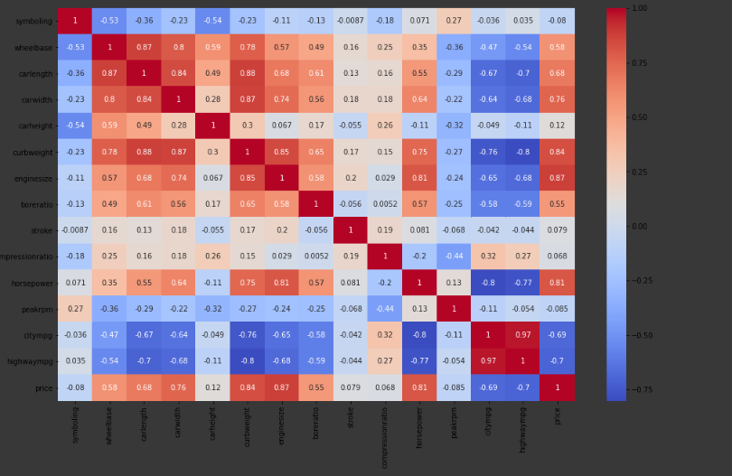

Slide 7
After the Heat Map, we defined all the variables as labels and plotted bar graphs between all the relationary labels. With the help of that, We identified some of the car features that are predominant in the US Automobile Market, Geely Automotives can consider these facts to full fill the market dominant needs and make the needed changes to their manufacturing line. These features are: symboling: moderate (0,1) Carbody: Sedan fueltype: gas aspiration: standard doornumbers: four drivewheel: forward engine location: front engine type: ohc cylinderNumber: four fuelSystem: mpfi We saw that TOYOTA was the most popular company in America at 15.6% followed by Nissan and Mazda.

Slide 8
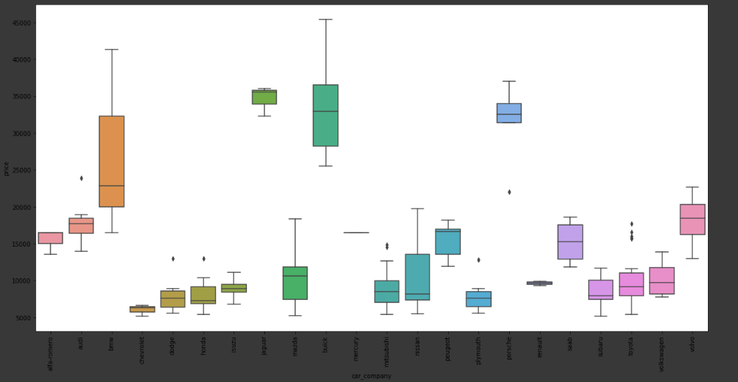
After that we plotted Boxplots and found out the Average price of U.S. cars. Average US car price: 13276.710570731706 The Top Prices for Companies are: Jaguar- 34600.000000 Buick- 33647.000000 Porsche- 31400.500000 BMW- 26118.750000 Volvo- 18063.181818

Slide 9

Outlier’s Treatment
In this, we see Compression ratio , price, horsepower have skewed distribution with each other.
From each of these variables we take out the value lying farther than 90% for compression due to fact it is most skewed and 95% for those which are slighly less skewed.

Slide 10
Linear and Logistic Regression
Creating the test and train variables and having them split in the ratio 80:20.
Fitting model on the training data using Linear Regression.
Making Predictions about Test Data.
Classifying will provide us with precision in our data.
Printing the Confusion Matrix and checking it with the predicted data value.

Slide 11
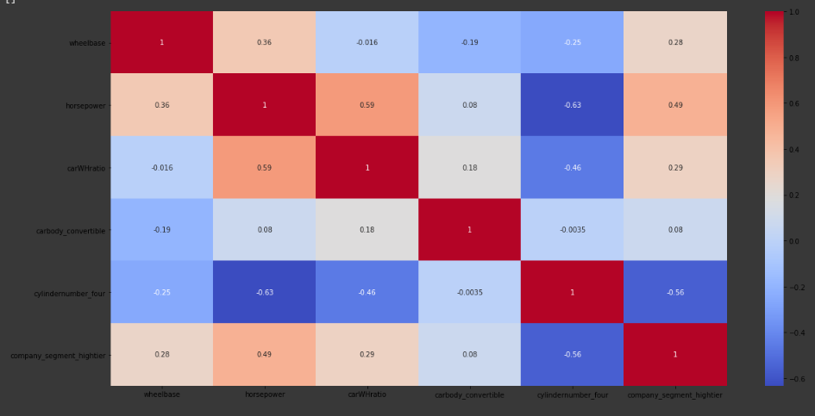
Training Model
Model testing on the Test data and comparison with Actual Data
Checking Predicted Data Values and Accuracy Score
Predicted data will prevent us from overfitting and underfitting.

Slide 12
Suggestions We would give
The chinese company Geely Automotives entering the US market should consider the below listed points,
Average US car price: 13000 USD(approx). For profitability and effective pricing of cars in this new market, the model's price predictors variables have to be regulated and balanced effectively to meet certain price levels and gain an edge over the other competitors. Also, keeping into account the predominating or the popular factors of a car in US market will give a better understanding of the needs and requirment of the citizens of USA.
symboling: moderate (0,1)
Carbody: Sedan
fueltype: gas
aspiration: standard
doornumbers: four
drivewheel: forward
engine location: front
engine type: ohc
cylinderNumber: four
fuelSystem: mpfi
This can be used to make the appropriate changes in design, features and the price offered to the customer.

